Slide 1
Using Natural Language Processing (NLP) to Identify Reportability of Cancer Reports
Nebraska Department of Health and Human Services
December 14th, 2022
Lifeng Li: Epidemiology Surveillance Coordinator
Bhavana Srinivas: ELR Informatics Specialist
Qianru Wu: Cancer Registry Informatician
Remy Poudel: DHHS Statistician
Yi Du: Healthcare Epidemiologist

Slide 2

Project Background
Data Science Problem:
Pathology laboratory may not have an effective filter to avoid non-reportable reports being sent.
About 1/3 of pathology reports received by the cancer registry were non-reportable.
Certified Tumor Registrar (CTR) needs to manually identify reportability for all reports received.
Project Goal:
Automate the identification process as much as possible
Align with Data Modernization Initiative (DMI):
Pursue innovation and explore new methods to strengthen data reporting, management, and analytics across public health, as well as to increase efficiency and accuracy

Slide 3

Project Summary
Evaluated project goal and explored potential solutions to achieve this goal.
  What we already have: data
  What is the current solution: manual review
  What needs to be employed: knowledge of NLP and python programming
  Where to get the resources: online courses and coach from CSTE
Took online courses to learn necessary data science skills.
The coach, Mr. Patric Prado, provided useful insights and suggestions for this project.
Communicated with other teams during the DSTT monthly meeting.
Invited CTR to introduce their current method of identifying reportability.

Slide 4

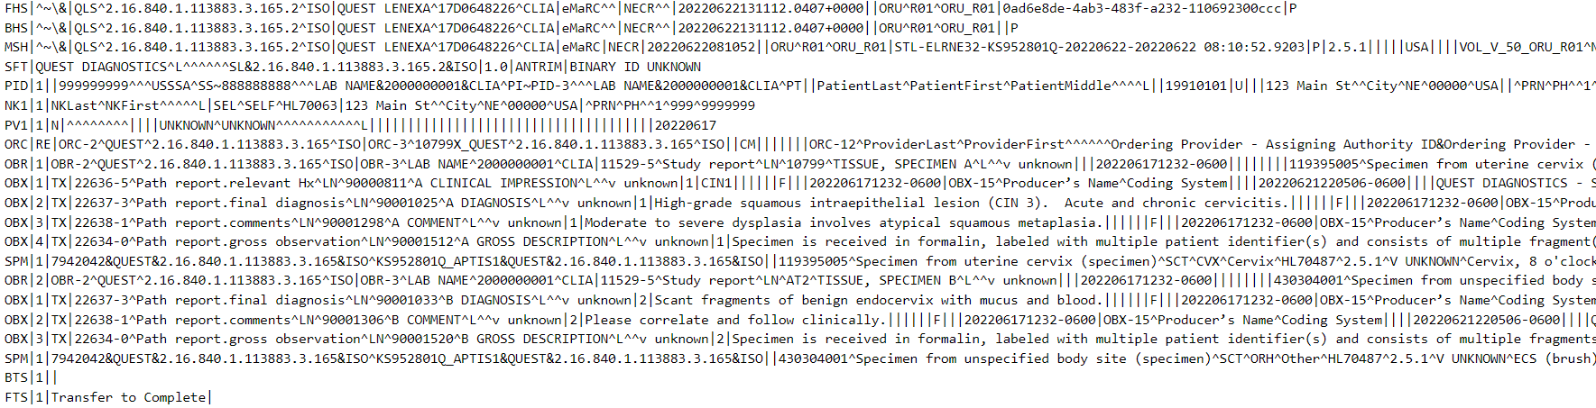
Data
Standard electronic pathology reports in HL7 format from 4 pathology laboratories, 4295 reports in total.
  Only diagnostic text in OBX-5 was analyzed
  All reports were de-identified
CTRs in the Nebraska Cancer Registry manually reviewed all reports and filtered out non-reportable reports. Then we compared the resulted and original datasets to encode each report.
0 – non-reportable 1 – reportable

Slide 5

Current Solutions
Use case-finding ICD-10 code list:
  Surveillance, Epidemiology, and End Results Program (SEER) case-finding ICD-10 code list: https://seer.cancer.gov/tools/casefinding/
  Note: this list includes more codes than those in the reportable list so as not to miss any reportable cases.
Analyze ambiguous terms manually:
Apparent(ly)
Appears
Comparable with Compatible with
Consistent with Favors
Malignant appearing Most likely
Presumed Probable
Suspect(ed) Suspicious (for)
Typical of
Tumor
Neoplasm
……

Slide 6
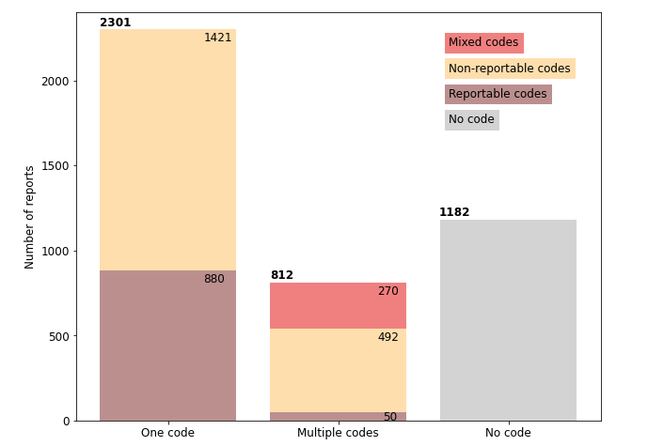
Results: ICD-10 Codes Summary
Number of reports contains:
One ICD-10 code: 2301
Multiple codes: 812
No code: 1182
Among reports with one code:
One reportable code: 880
One non-reportable code: 1421
Among reports with multiple codes:
Different codes, all reportable: 50
Different codes, all non-reportable: 492
Both reportable and non-reportable codes: 270
Hypothesis: a report is reportable if it contains reportable ICD-10 code(s).
Include only the reports containing at least one ICD-10 code (3113 reports in total – 72% of all reports).
Accuracy: 58%

Slide 7
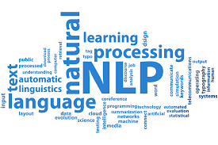
NLP Solution
Text preprocess:
Remove Stop Words
Remove Punctuations
Assign Part-Of-Speech Tags
Lemmatization
Tokenization
A dog ran away.
['A', 'dog', 'ran’, 'away', '.']
['A', 'dog', 'ran', 'away', '.']
['dog', ‘ran', 'away', '.']
['dog', ‘ran', 'away', '.']
['dog', ‘ran', 'away']
('dog', 'NN'), ('ran', 'VBD'), ('away', 'RB’)
NN: noun, singular
VBD: verb, past tense
RB: adverb
dog → dog
ran → run
away → away
Vectorization:
Frequency vector / Count vector
Term frequency-Inverse Document Frequency (TF-IDF) vector
Model selection for text classification:
Naïve Bayes
Logistic Regression
Linear Support Vector Machine

Slide 8

Challenges and Solutions
Lack of technical knowledge: only one team member has experience in NLP
  Solutions:
    Shared NLP knowledge internally
    Took online courses and utilized recourses provided by the coach
Lack of domain knowledge: only two team members have experience in cancer data
  Solutions:
    Shared domain knowledge internally
    Invited CTRs to introduce the current methods
Data is not labeled
  Solution:
    Invited CTRs to filter out non-reportable
    Compared the filtered data with the original

Slide 9
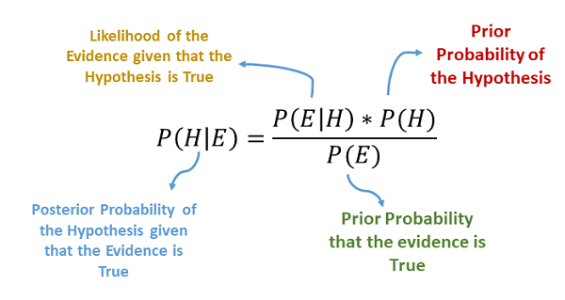
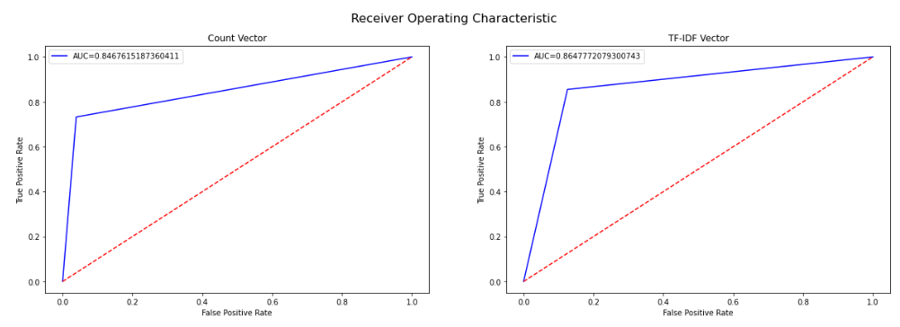
Results
Naïve Bayes Model:
Accuracy:
  Count vector: 79%
  TF-IDF: 86%

Slide 10

Results
Logistic Regression using TF-IDF vector:
Accuracy: 82%
Linear Support Vector Machine using TF-IDF vector:
Accuracy: 87%
    precision recall f1-score support
    -----------------------------------------------------
    Reportable 0.74 0.81 0.77 231
    Non-reportable 0.93 0.89 0.91 628
    accuracy 0.87 859
    macro avg 0.83 0.85 0.84 859
    weighted avg 0.88 0.87 0.87 859

Slide 11

Future work
Continue exploring more NLP models and data science methods to optimize the results
  Combine multiple models
  Divide the dataset and apply different models to different subsets
Present the results from DSTT to other public health programs to broaden the scope of NLP applications
Team members will continue to collaborate to solve data science problems in our department

Slide 12
Acknowledgement
We would like to take this opportunity to express our gratitude to the following professionals of whom contributed to the success of this program.
01
02
03
Coach
CTR from Westat
DHHS Administrator
Patric Prado
Elaine Flores
Raquel Brown
Dr. Ming Qu
Thank you!
Notes:
Thank you for listening and I will take questions.

